Slide 1
Authentication, authorization and AUDIting
Lecture 13 Instructor: Dr. Zainab Abaid

Slide 2
Authentication, Authorizations, and Auditing
AAA Protections
Authentication-supplicant sends credentials to verifier to authenticate the supplicant
Authorization-what permissions the authenticated user will have
Auditing-recording what people do in log files
Notes:
These are the 3 functions of access control.
Authorization: For example, Bob may have permission to read a file but not to change it or delete it. Carol may not even have permission to see the file’s name.

Slide 3
authentication
Passwords, biometrics, access tokens and more.

Slide 4

Authentication
Credentials Are Based on
What you know (e.g., a password)
What you have (e.g., an access card)
What you are (e.g., your fingerprint)
What you do (e.g., speaking a passphrase)

Slide 5
Two-Factor Authentication
Two-Factor Authentication
Use two forms of authentication for defense in depth
Example: access card and personal identification number (PIN)
Multifactor authentication: two or more types of authentication
Can be defeated by a Trojan horse on the user’s PC
Can also be defeated by a man-in-the-middle attack by a fake website
Notes:
e.g. Eurograbber did both these.
First, if a client PC is infected with a Trojan horse, the Trojan horse can send transactions when a user has already authenticated himself or herself to an e-commerce site. If a user’s computer is compromised, two-factor authentication means nothing.
Second, two-factor authentication often can be defeated with a man-in-the-middle attack. If a user logs into a fake banking website, the fake site can act as a silent go-between to the real banking website. After the user successfully authenticates, the fake website can execute transactions of its own on the real website.

Slide 6
Passwords (1 of 5)
Reusable password
Password used for weeks or months at a time
One-time password
Used only once

Slide 7
Passwords (2 of 5)
Difficulty of cracking passwords by guessing remotely
Account is usually locked after a few login failures
Password-cracking programs
Password-cracking programs exist
Notes:
Many ways of password cracking exist; e.g. steal password file and crack it later. E.g. some wifi password cracking tools steal network packets and try to reverse the encryption offline.

Slide 8
Passwords (3 of 5)
Password Policies
Not using the same password at multiple sites
Password duration policies
Shared password policies (makes auditing impossible)
Disabling accounts that are no longer valid
Lost passwords (password resets)
Notes:
Especially don’t use the password for a secure site such as banking in other sites that aren’t so secure, as it may leak from the less secure place. Sometimes attackers invite victims to an attractive site that requires creating a username and password and then try it on other sites. You can use password managers that enforce strong passwords and remember them but it becomes problematic when you need to use accounts across devices.
Shared password: e.g. Netflix account often shared. One the password is not changed. Two audit logs cant tell which of the users used the account inappropriately. Bayyinah account sharing is good.

Slide 9
Passwords (4 of 5)
Password Policies
Opportunities for social engineering attacks
Automated password resets use secret questions (Where were you born?)
Password policies must be long and complex
Testing and enforcing passwords
Passwords must be stored as secure hashes
Passwords should be audited regularly
Notes:
Lost passwords: lots of social engg attacks possible. E.g. call help desk pretending to be another user and get paswrod reset. Or call user pretending to be IT and ask for pw.
Secret question issues: spelling errors, you may not remember as several correct answers, or themselves a security issue, e.g. asking for mother’s name or social security number. Or may be possible to answer with some research. E.g. Sarah Palin Yahoo mail account hacked by researching answers to her secret questions and resetting password. A year in jail.
Long password trick: from first characters of long phrase.

Slide 10
Passwords (5 of 5)
The End of Passwords?
Many firms want to eliminate passwords because of their weaknesses
Quite a few firms have already largely phased them out

Slide 11
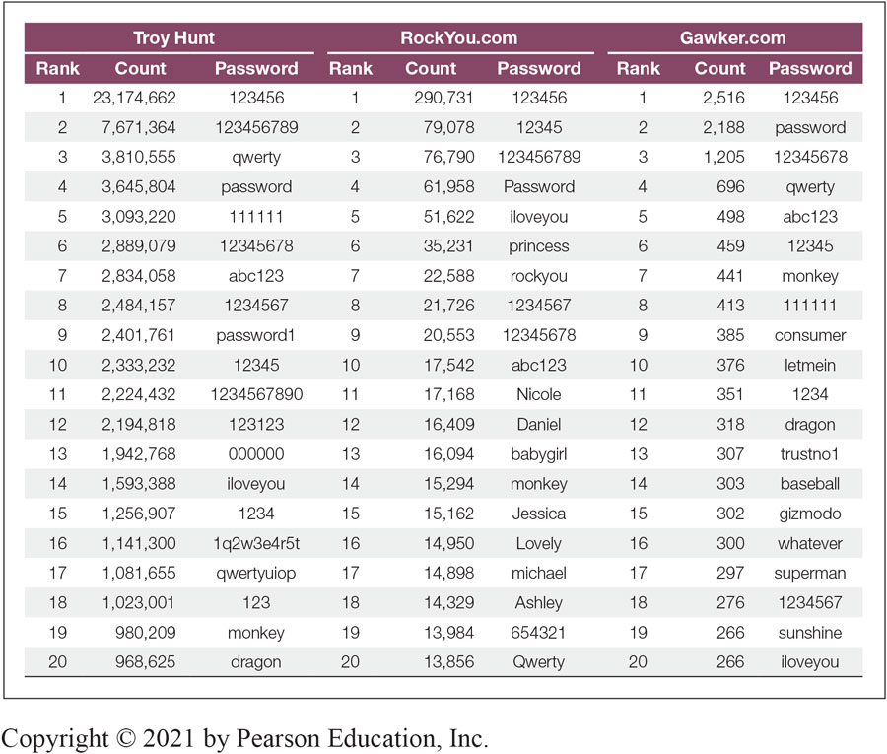
Common Passwords
Notes:
Figure 5-6 shows the top 20 most commonly used passwords for two real-world data breaches.

Slide 12
Biometric Authentication (1 of 14)
Biometric Authentication
Authentication based on biological (bio) measurements (metrics)
Major promise of biometrics is to make reusable passwords obsolete
Notes:
We can forget passwords and lose access cards. But bodies always with us. Something you ARE or something you DO (e.g. walk or write)

Slide 13
Biometric Authentication (2 of 14)
Biometric Systems
Enrollment (enrollment scan, process for key features, store template)
Later access attempts provide access data, which will be turned into key feature data for comparison with the template
Biometric access key features will never be exactly the same as the template

Slide 14
Biometric Authentication (3 of 14)
Biometric Systems
There must be configurable decision criteria for deciding how close a match (match index) to require
Requiring an overly exact match index will cause many false rejections
Requiring too loose a match index will cause more false acceptances
Notes:
When a system receives access data, it computes a match index, which is the difference between the scan’s key features and the template. There is never a perfect match, because scanning never works exactly the same way twice. If the error is smaller than a value called the decision criterion, the supplicant is accepted as a match. If not, the sup- plicant is rejected as a match.

Slide 15
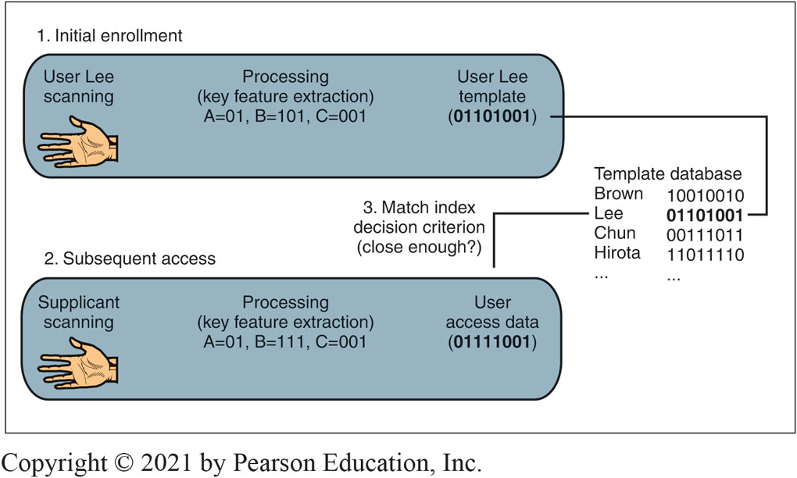
Biometric Authentication System
Notes:
This figure shows a biometric authentication system.

Slide 16
Biometric Authentication (4 of 14)
Errors versus Deception
Error rate
Refers to accuracy when the supplicant is not trying to deceive the system
Deception rate
The likelihood that an impostor will be able to deceive the system if he or she tries

Slide 17
Biometric Authentication (5 of 14)
False Acceptance Rates (FARs)
Percentage of people who are identified or verified as matched to a template but should not be
False Rejection Rates (FRRs)
Percentage of people who should be identified or verified as matches to a template but are not
Notes:
It is important to take these metrics reported by manufacturers with a grain of salt.
The rate of false acceptances as a percentage of total access attempts is called the false acceptance rate (FAR).
The false rejection rate (FRR) is the probability that the system will reject a person who should be matched to a template.
Note that false rejections, like false acceptances, have different implications for different uses— door or computer access versus terrorist watch lists.
WHIcH Is Worse? Which is worse, then—a false acceptance or a false rejection? It depends on the context. In door or server access, a false acceptance allows an attacker in and is a serious violation. A false rejection is simply an inconvenience. For terrorist watch list matching, how- ever, a false rejection (a failure to match an attacker to a watch list template) is a major security violation. A false acceptance, in turn, is only a nuisance.

Slide 18
Biometric Authentication (6 of 14)
Vendor Claims for FARs and FRRs
Tend to be exaggerated through tests under ideal conditions
Failure to Enroll (FTE)
Subject cannot enroll in system
E.g., poor fingerprints due to construction work, clerical work, age, etc.
Notes:
vendor clAIMs Unfortunately, vendor claims for FARs and FRRs can be misleading. They usually are based on idealized situations that are not representative of real-world conditions. For instance, we have seen that the false acceptance rate increases as the number of templates increases because there is a small false acceptance probability for each template. To take advan- tage of this, vendors may base FAR estimates on databases with only a few templates.
In addition, vendors enroll users under ideal circumstances and have ideal situations for the access attempt. For instance, in face recognition, their test subjects might be very well lit and looking straight forward for both enrollment and access attempts—conditions that are not likely to occur in the real world. This can make a vendor’s reported false rejection rate lower than it would be in practice.

Slide 19
Biometric Authentication (7 of 14)
Deception
Errors: when subject is not trying to fool the system
Deception: when subject is trying to fool the system
Many biometric methods are highly vulnerable to deception
Notes:
e.g. fingerprints on gelatin finger.

Slide 20
Biometric Authentication (8 of 14)
Verification
Supplicant claims to be a particular person
Is the supplicant who he or she claims to be?
Compare access data to a single template (the claimed identity)
Verification is good to replace passwords in logins
If the probability of a false acceptance (false match) probability is 1/1000 per template match,
The probability of a false acceptance is 1/1000 (0.1%)
Notes:
Biometric authentication has one of three possible goals.
Verification is goal 1.
In verification, the verifier determines whether the supplicant is a particular person.

Slide 21
Biometric Authentication (9 of 14)
Identification
Supplicant does not state his or her identity
System must compare supplicant data to all templates to find the correct template
If the probability of a false acceptance (false match) probability is 1/1000 per template match,
and if there are 500 templates in the database, then
the probability of a false acceptance is 500 * 1/1000 (50%)
Good for door access
Notes:
Second goal.
IdentIFIcAtIon In identification, by contrast, the supplicant does not claim to be a particu- lar person. It is the job of the system to identify the supplicant, that is, to determine who he or she is.
In identification, the system makes many matches between the applicant’s access data and the templates in the system. With each match, there is a small danger of a false match (false acceptance). Given the many matches required in identification compared with the single match required in verification, the chance of a false match is much higher in identification than it is in verification.
On the positive side, identification frees users from the need to type their names or account names. Identification is best for door access control and other situations in which identity claims cannot be made by the supplicant.

Slide 22
Biometric Authentication (10 of 14)
Watch Lists
Subset of identification
Goal is to identify members of a group:
More comparisons than verification but fewer than identification, so the risk of a
false acceptance is intermediate
If the probability of a false acceptance (false match) is 1/1,000 per template match,
and if there are 10 templates in the watch list, then
the probability of a false acceptance is 10 * 1/1,000 (1%)
Notes:
Third goal.

Slide 23
Biometric Authentication (11 of 14)
Fingerprint Recognition
Simple, inexpensive, well proven
Most biometrics today are fingerprint recognition
Often can be defeated with latent fingerprints on glass copied to gelatin fingers
Fingerprint recognition can take the place of reusable passwords for low-risk applications

Slide 24
Biometric Authentication (12 of 14)
Iris Recognition
Pattern in colored part of eye
Uses a camera (no light is shined into eye, as in Hollywood movies)
Very low FARs
Very expensive
Notes:
Iris scanners can read iris patterns from several centimeters to a meter or so away.15 In movies, iris scanning typically is shown as a red laser beam shining into the supplicant’s eye. This is complete nonsense. With iris scanners, people simply look into ordinary cameras. There is typically a small TV monitor to help the supplicant ensure that he or she is looking directly into the camera.

Slide 25
Biometric Authentication (13 of 14)
Face Recognition
Surreptitious identification is possible (in airports, etc.)
Surreptitious means without the subject’s knowledge
High error rates, even without deception
Hand Geometry for Door Access
Shape of hand
Reader is very large, so usually used for door access
Notes:
Auckland airport testing 3D image recognition when person walks through smart gate.

Slide 26
Biometric Authentication (14 of 14)
Voice Recognition
High error rates
Easily deceived by recordings
Other Forms of Biometric Authentication
Veins in the hand
Keystroke recognition (pace in typing password)
Signature recognition (hand-written signature)
Gait (way the person walks) recognition

Slide 27
Behavioral biometrics
Tracking eye movement, gait etc. to authenticate, or to continuously ensure that initial authentication has not been bypassed
Web based behavioral biometrics: using mouse movements, typing patterns, usual action profile etc. to identify web impersonation.
Reading:
https://expertinsights.com/insights/a-guide-to-behavioral-biometrics/

Slide 28

Authorization

Slide 29
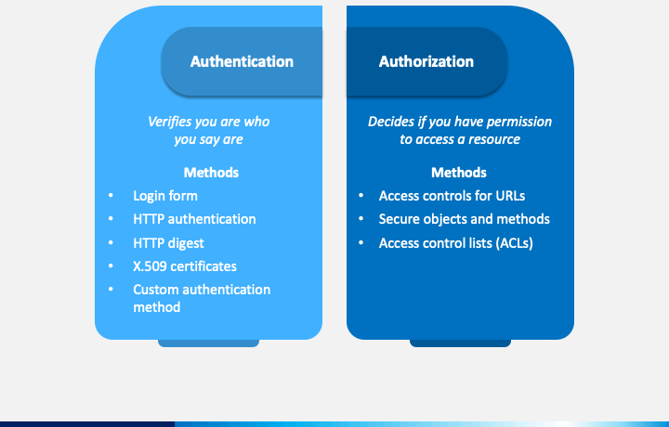
Notes:
Image source: https://cdn.sketchbubble.com/pub/media/catalog/product/optimized1/2/0/20914a93cd515cf5a49ad452bf55c1cd375c957b04f1ca26844e51194334d403/authentication-and-authorization-slide3.png

Slide 30
Authorization (1 of 3)
Authorizations
Authentication: Proof of identity
Authorization: The assignment of permissions (specific authorizations) to individuals or roles
Just because you are authenticated does not mean that you should be able to do everything

Slide 31
Authorization (2 of 3)
Principle of Least Permissions
Initially give people only the permissions a person absolutely needs to do his or her job
If assignment is too narrow, additional permissions may be given
System has permissions A, B, C, D, E, and F
This will frustrate users somewhat

Slide 32
Authorization (3 of 3)
Giving Extensive or Full Permissions Initially Is Bad
User will almost always have the permissions to do his or her job
System has permissions A, B, C, D, E, and F
Assignments can be taken away, but this is subject to errors
Such errors could give excessive permissions to the user
This could allow the user to take actions contrary to security policy
Giving all or extensive permissions and taking some away does not fail safely

Slide 33
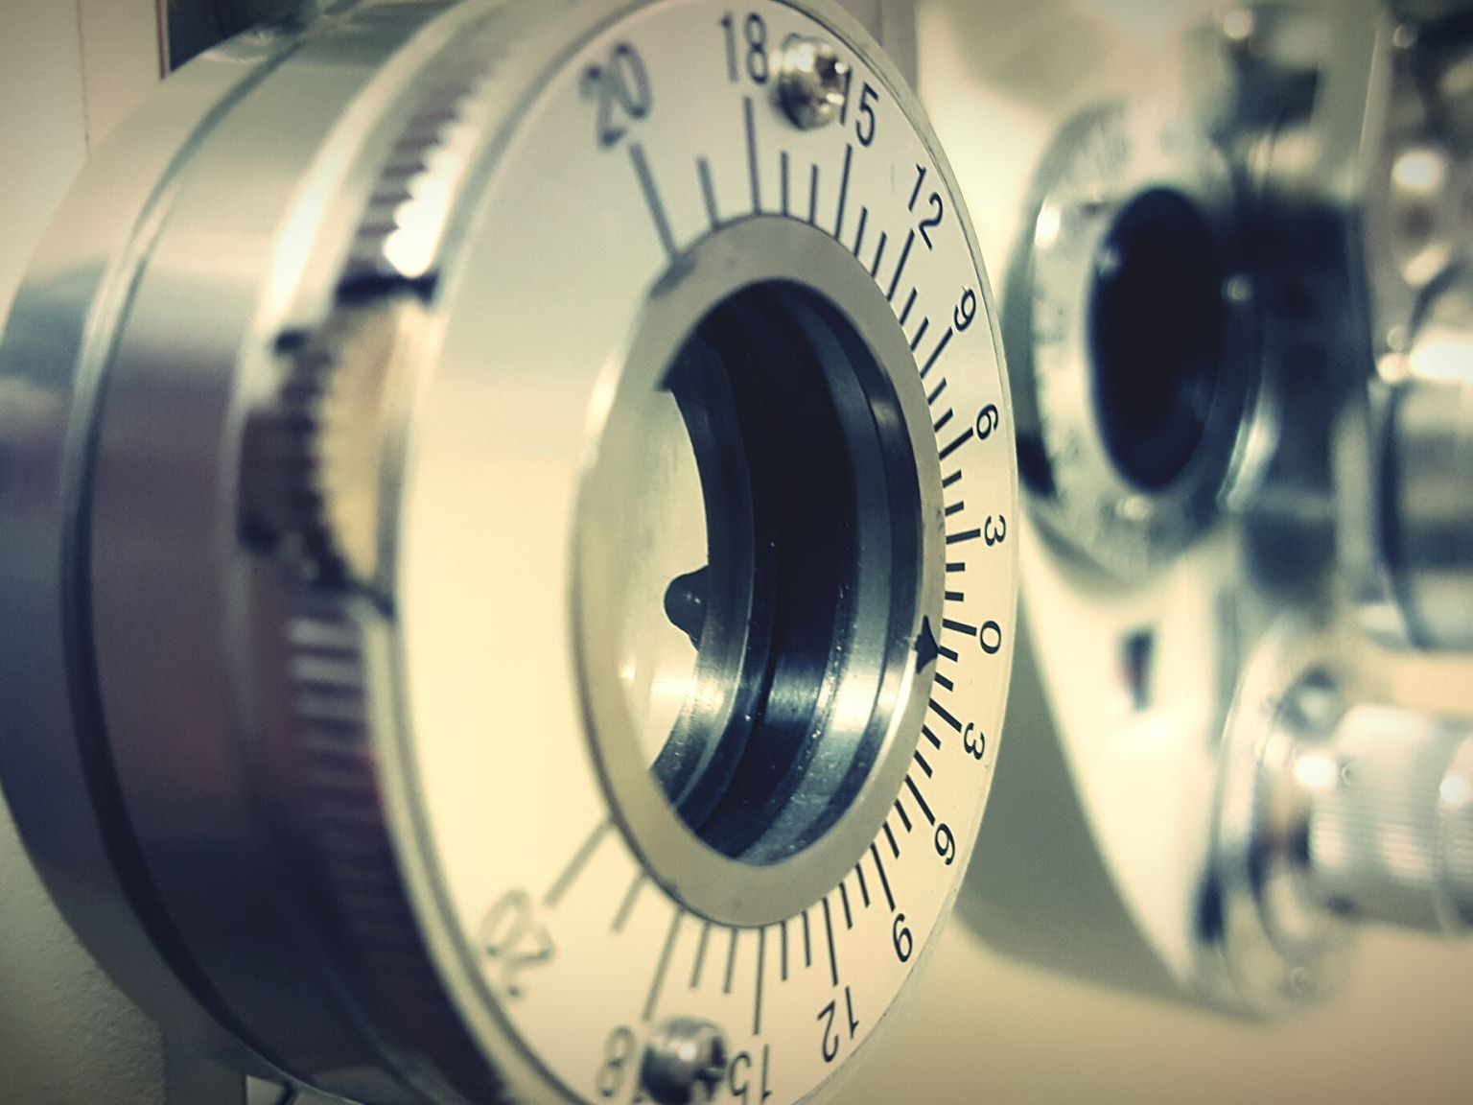
Access control

Slide 34
Access Control
Access Controls
Firms must limit access to physical and electronic resources
Access control is the policy-driven control of access to systems, data, and dialogues
Cryptography
Many access control tools use cryptography to some extent
However, cryptography is only part of what they do and how they work
Notes:
all security begins with the devel- opment of security policies for individual resources
Not all access control is cryptography

Slide 35
Individual and Role-Based Access Control
Individual and Role-Based Access Control
Individual access control: bases access rules on individual accounts
Role-based access control (RBAC)
Human and Organizational Controls
People and organizational forces may circumvent access protections
Notes:
RBAC benefits: cheaper and easier to manage than individual permissions; less chance of errors; easier revocation.
Human is always the weakest link; also humans may abuse trust.

Slide 36
auditing

Slide 37
Auditing (1 of 3)
Auditing
Authentication: Who a person is
Authorization: What a person may do with a resource
Auditing: What the person actually did

Slide 38
Auditing (2 of 3)
Logging
Events
On a server, logins, failed login attempts, file deletions, and so forth
Events are stored in a log file

Slide 39
Auditing (3 of 3)
Log Reading
Regular log reading is crucial or the log becomes a useless write-only memory
Periodic external audits of log file entries and reading practices
Automatic alerts for strong threats

Slide 40
references
Some of the slide material is sourced from:
https://garantir.io/key-based-authentication/#:~:text=Key%2Dbased%20authentication%2C%20also%20called,widely%20throughout%20every%20enterprise%20environment.
Slides for the book Corporate Computer Security (Boyle)

Slide 41

Copyright
This work is protected by United States copyright laws and is provided solely for the use of instructors in teaching their courses and assessing student learning. Dissemination or sale of any part of this work (including on the World Wide Web) will destroy the integrity of the work and is not permitted. The work and materials from it should never be made available to students except by instructors using the accompanying text in their classes. All recipients of this work are expected to abide by these restrictions and to honor the intended pedagogical purposes and the needs of other instructors who rely on these materials.

